Slide 1


The ELK Stack
A top tool for text warehousing and visualization

Slide 2



What is the ELK Stack?
ELK consists of three integrated but separate projects from the open-source vendor Elastic.
Notes:
ELK is that only through the cloud.

Slide 3

Elasticsearch is a Distributed Search and Analytics Engine, Ideal for Storing and Analyzing Text Data
Elasticsearch is fast and scalable.
Can run on the cloud through services like AWS or Google Cloud,, and integrates with Hadoop
Can index data without schema, so users can integrate text data from multiple sources for centralized analysis
Features built-in analyzers for cleaning, tokenizing, and removing stop words
Uses the Lucene query language to provide powerful full-text search capabilities
Notes:
They might leave sooner, take fewer rides in their visit. (They might perceive the park as having unexpected ride closures.)
The image itself might be distracting because it is mostly text.

Slide 4

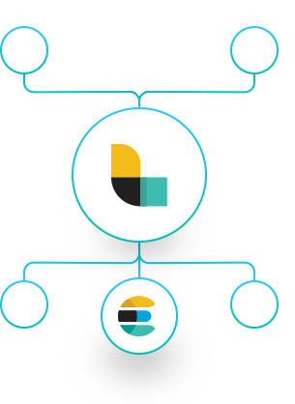
Logstash Ingest and Transforms Data for Delivery to Elasticsearch
Logstash can ingest data from diverse sources, like Amazon S3, logs simultaneously to convey it to a user’s “stash.”
Logstash transforms data during ingest, allowing users to parse and filter unstructured data.
Notes:
They might leave sooner, take fewer rides in their visit. (They might perceive the park as having unexpected ride closures.)
The image itself might be distracting because it is mostly text.

Slide 5

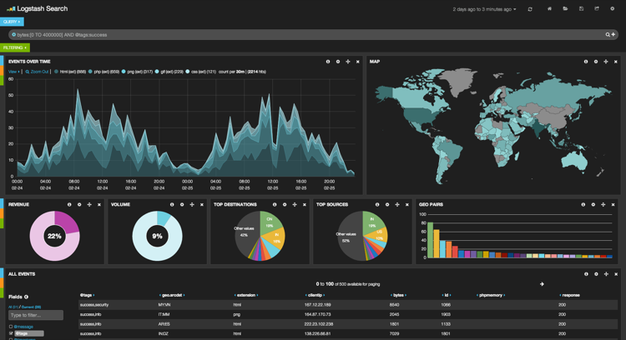
Kibana is a Powerful Tool for Exploring and Visualizing Data, with Special Visuals for Text
Provides an interactive word cloud visualization that allows users to filter on significant terms
Facilitates easy visualization of data from multiple sources simultaneously
Kibana’s Graph plug-in provides an interactive, iterative search tool for text
Notes:
They might leave sooner, take fewer rides in their visit. (They might perceive the park as having unexpected ride closures.)
The image itself might be distracting because it is mostly text.

Slide 6

Our Business Case: Market Research for New Product Development
How can we use this rich data set of insights from enthusiasts and professionals to learn what new beers could succeed in the market?
Notes:
They might leave sooner, take fewer rides in their visit. (They might perceive the park as having unexpected ride closures.)
The image itself might be distracting because it is mostly text.

Slide 7

Our Data Set: 500,000 reviews from
BeerAdvocate.com
Covers a time period of more than 10 years, up to November 2011
Reviewers rate beers on five dimensions and give a plaintext review
Reviews also include product and user information
Notes:
They might leave sooner, take fewer rides in their visit. (They might perceive the park as having unexpected ride closures.)
The image itself might be distracting because it is mostly text.

